Slide 1

Bed Bath
& Beyond
*
Gregory, Chris, Kevin, and Himanshu

Slide 2
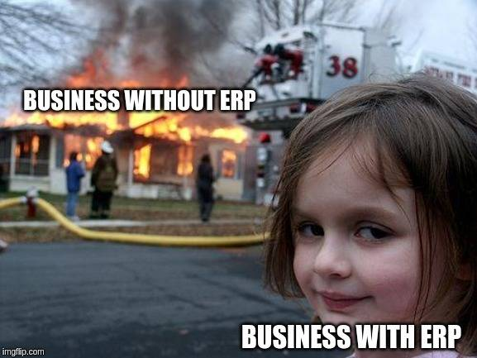

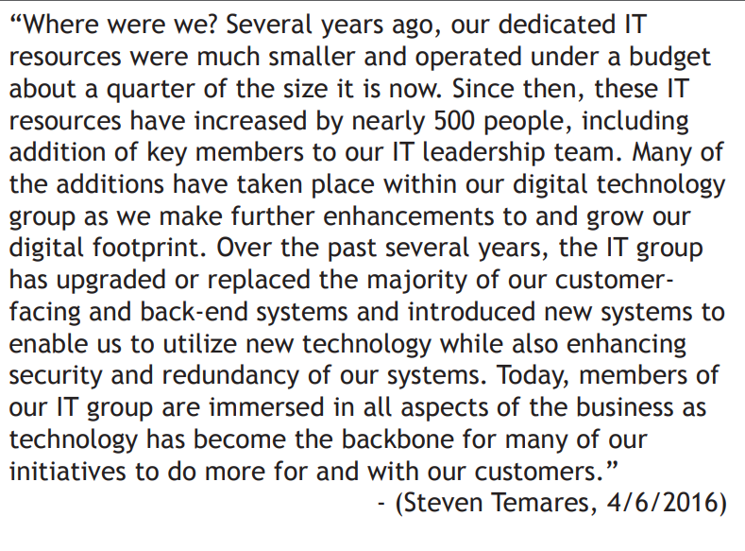

*
IT INVESTMENTS
“Led by old folks whom have no grasp on technology” (anonymous, NY, NY 9/18)
“The company isn’t willing to invest in emerging technologies and breing old outdated systems to help alleviate pressure on associated and a safe working environment”. (anonymous, 11/18)

Slide 3
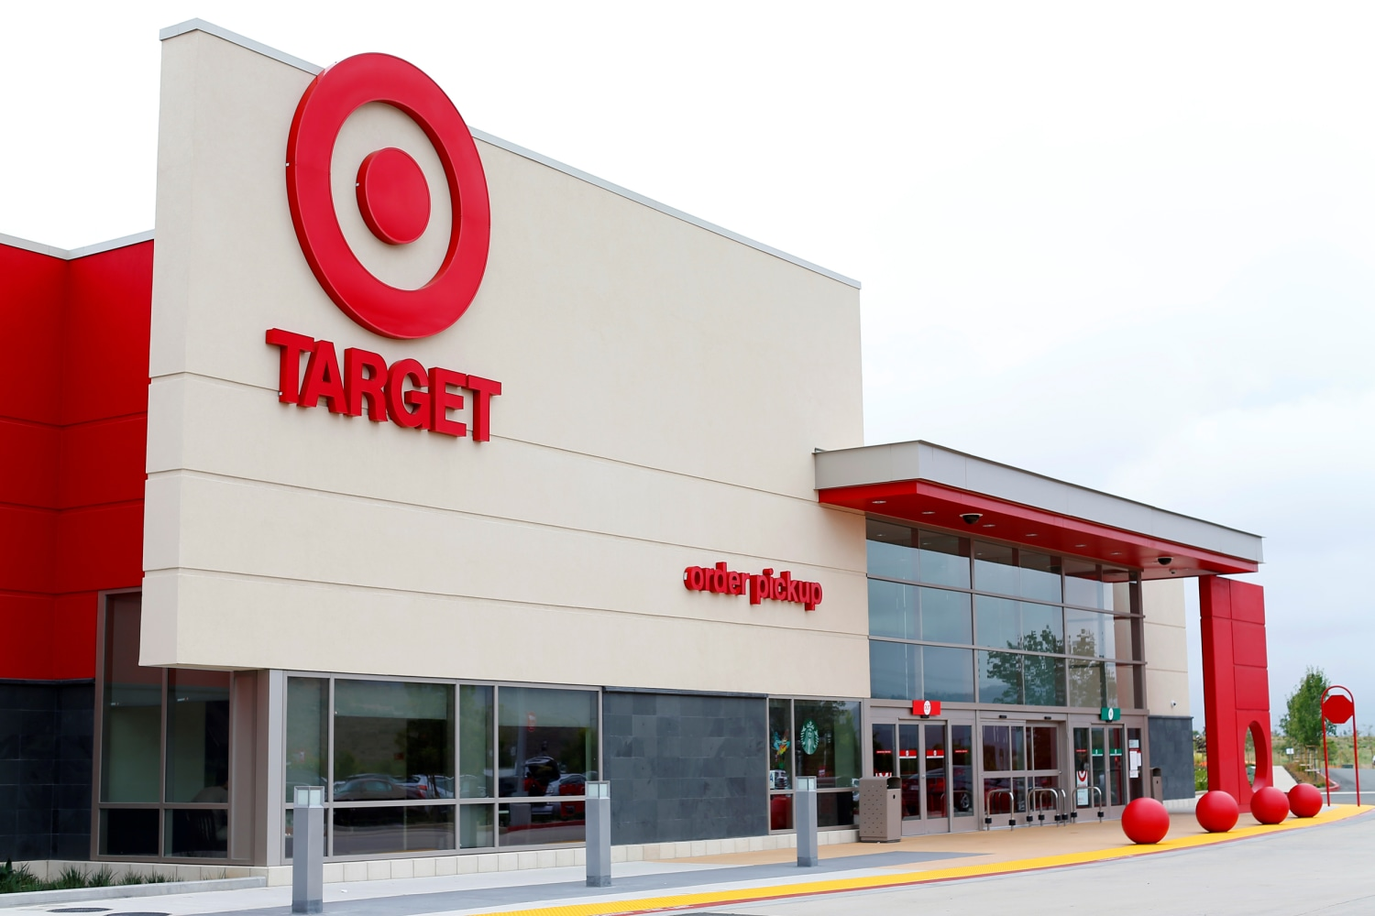


COMPETITION FROM
BRICK-AND-MORTAR
New Market Entrants
Lack of In Store Experience
Inefficient Omnichannel strategy
Improper pricing architecture
No in-store customer services and solution
*

Slide 4

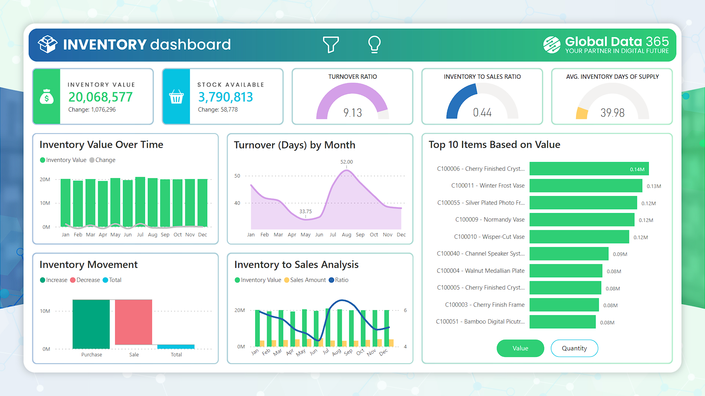
Geographic Areas Served
*
*
Problems:
Overexpansion, inefficient store sizes, mismatch
between store offerings and local market needs.
Solutions:
Geographic Information System (GIS) Integration
Store Portfolio Management through Performance Dashboards

Slide 5
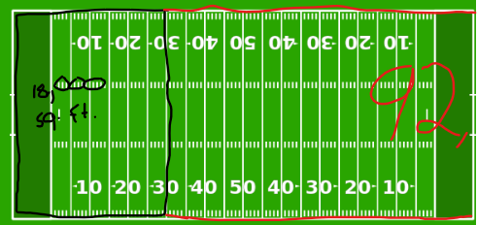
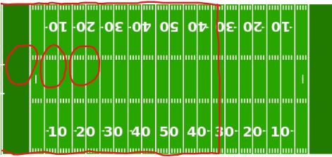



SIZE OF STORES
*
What can be done in 92,000, can be done in 18,000 just as efficiently.
Extra Real Estate Possibilities

Slide 6
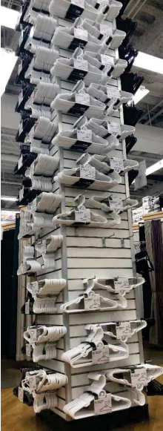
MERCHANDISE & INVENTORY
*
Cluttered Displays
Decentralized -> Centralized
VERY Broad Range of Products
Predictive Analysis, Inventory Management System

Slide 7


PRICING
*
*
Problems:
Inconsistent pricing, higher cost perceptions
Solutions:
Dynamic and Strategic Pricing
Advanced Pricing Analytics
Enhanced Value Perception

Slide 8

Private Labels vs
Brand Names
Lack of understanding of customer needs and demands
Inefficiencies in sourcing goods
Lack of a comprehensive marketing strategy
Product Quality Perception

Slide 9

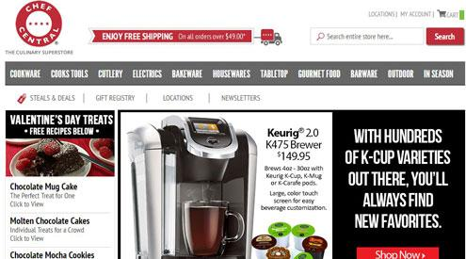
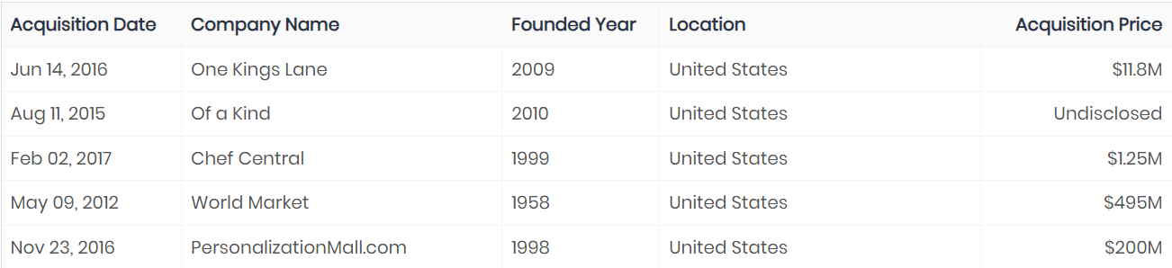


Mergers & Acquisitions
*
Inexperienced / No long term strategy
Sell or liquidate certain brands and halt any further acquisitions
A new capital allocation framework
Weakened brand identity

Slide 10



COMPETITION FROM E-COMMERCE
Growing pressure from e-commerce
Amazon
Target
Wayfair
Declining sales and loss of market share
E-commerce sites had lower prices and wider variety
Neglected e-commerce

Slide 11
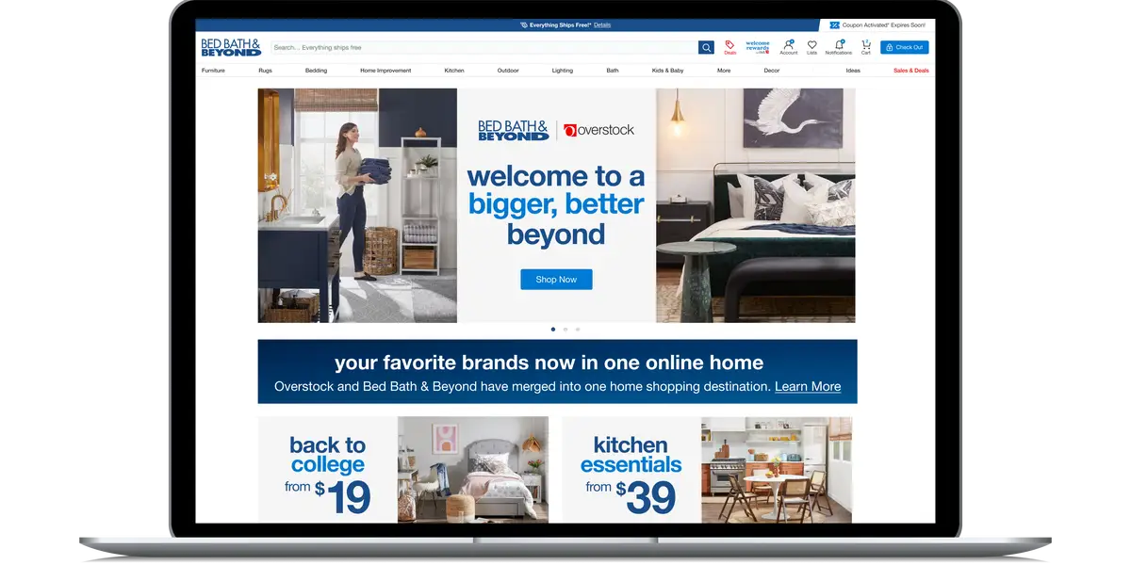
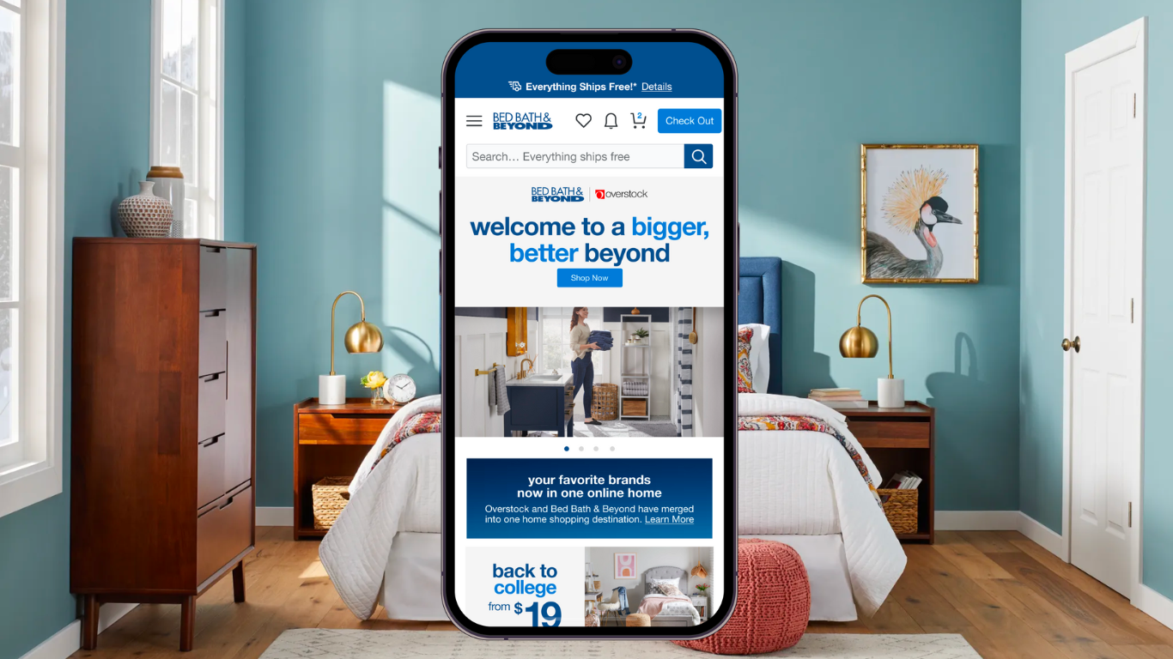
*
DIGITAL CHANNELS
Create a cohesive Bed Bath & Beyond website and app
One-stop-shop with wider assortment of goods
Showcase a variety of products with a focus on categories such as:
Bedding, Decor, Furniture, Appliances
Exclusive discounts
Seamless in-store and online shopping experience

Slide 12


*
LOYALTY PROGRAMS
Invest in a Customer Relationship Management system (CRM)
Tiered Loyalty Program
Free: Earn points for each purchase and receive monthly promotions
Paid: Get exclusive discounts, faster shipping, and promotions
Personalized Recommendations
“Beyond Savings Day”

Slide 13

DIGITAL MARKETING
Use CRM to tailor marketing campaigns
Improve our online presence
Use email, social media, and pay-per-click advertisements
Influencer marketing
Focus on good branding emphasizing quality and variety
Direct ads at target demographic
Homeowners/Upper Middle Class/Higher Disposable Income
*

Slide 14

Innovation
*
Problems:
Executives that are not familiar with technology
Solution:
Innovation Management Systems

Slide 15
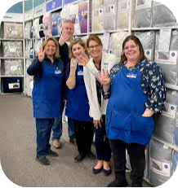


*
HIRING/STAFF RETENTION
Problem:
Company Culture
Improper employee metrics
Lack of Training programs
Solution:
New incentive program
Clear goals and targets
Proper marketing

Slide 16
Thanks!
Do you have any questions ?
*
*
*
*

